Slide 1
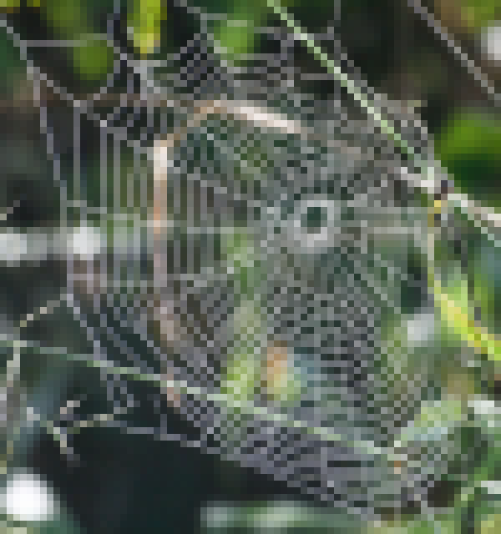
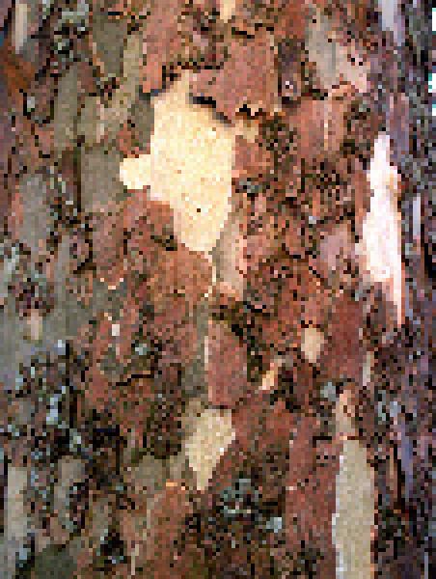
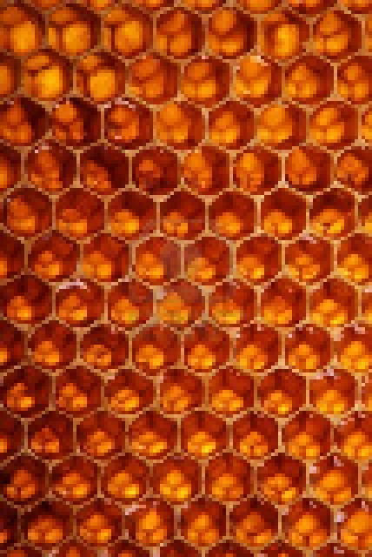

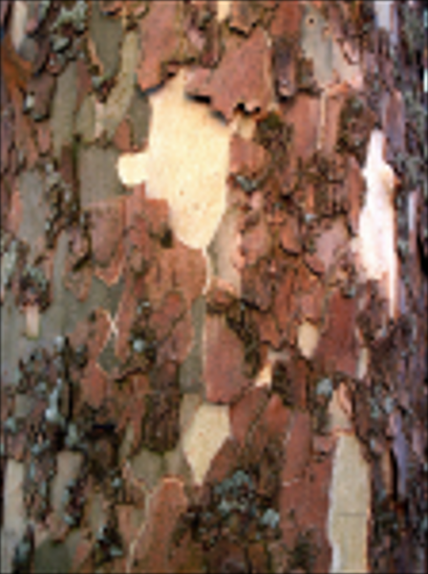
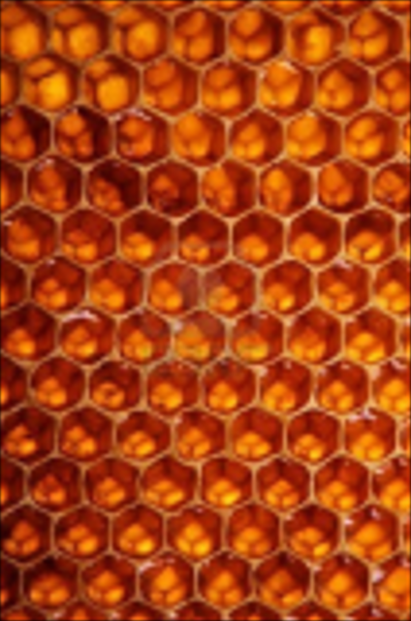
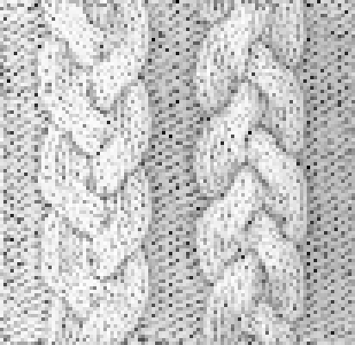
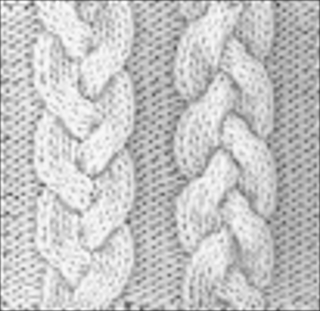
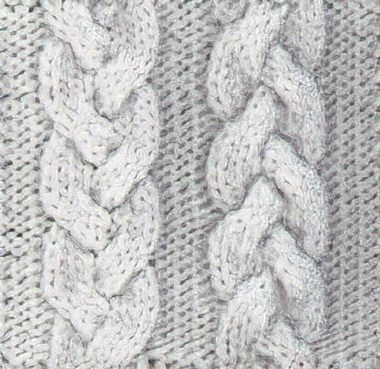


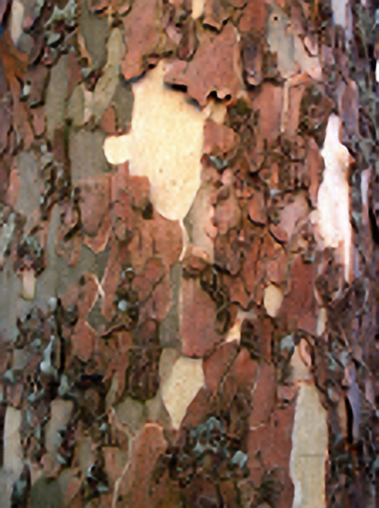
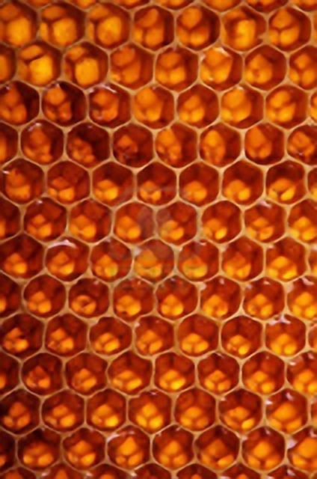

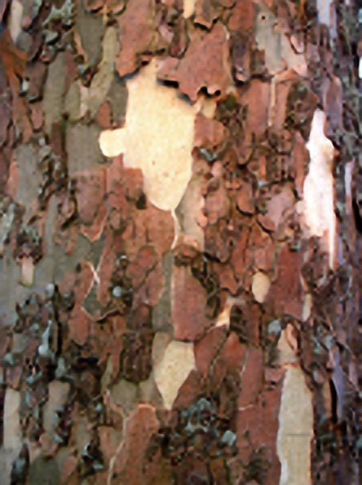


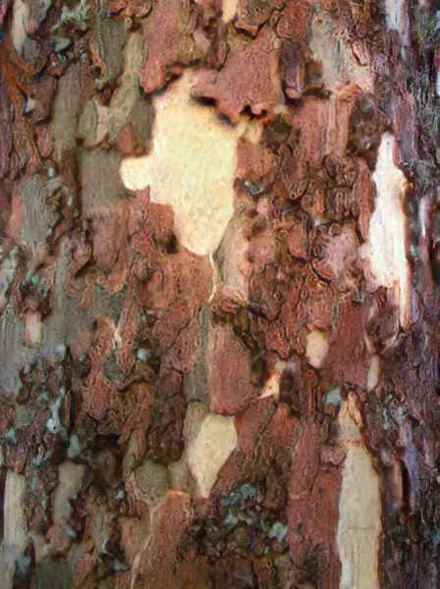
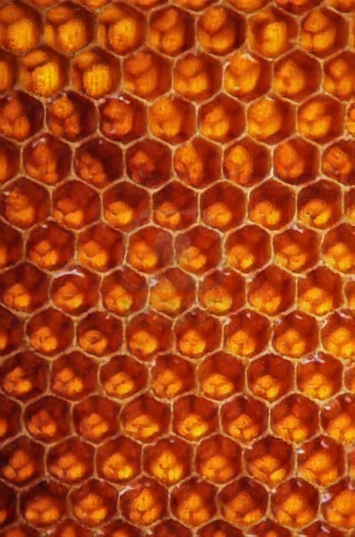


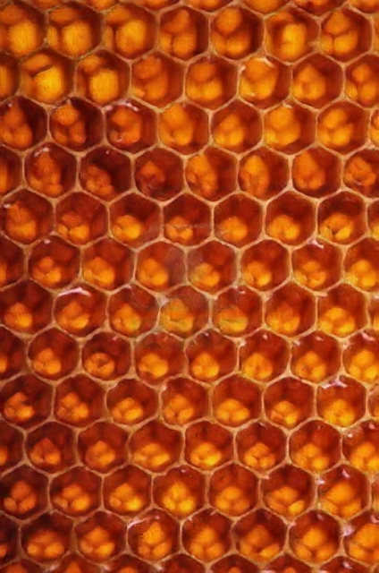
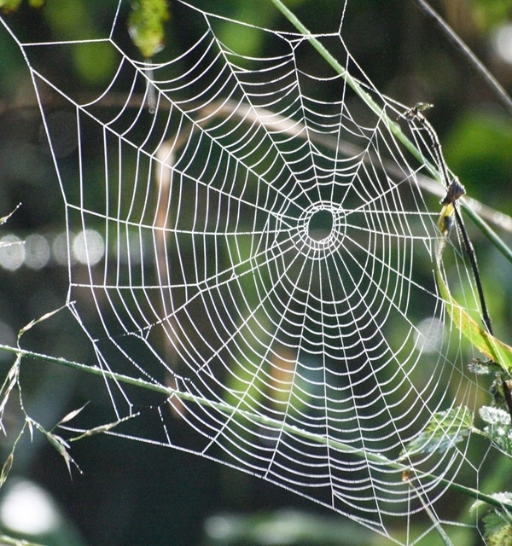

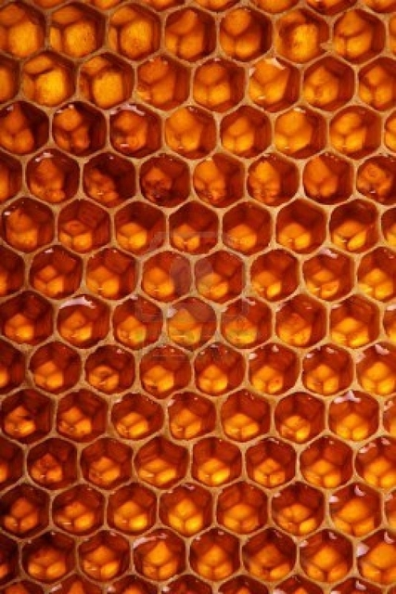


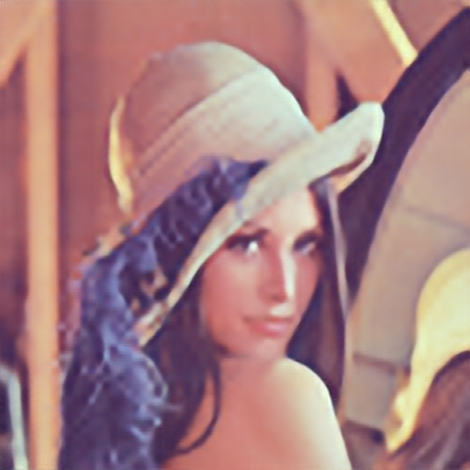
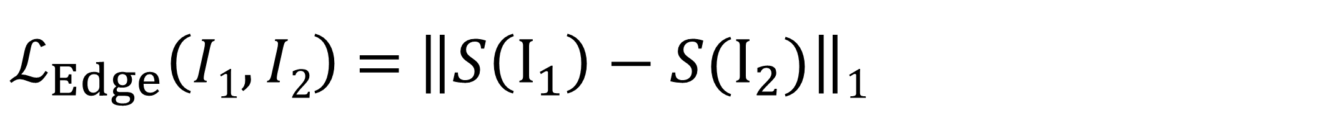
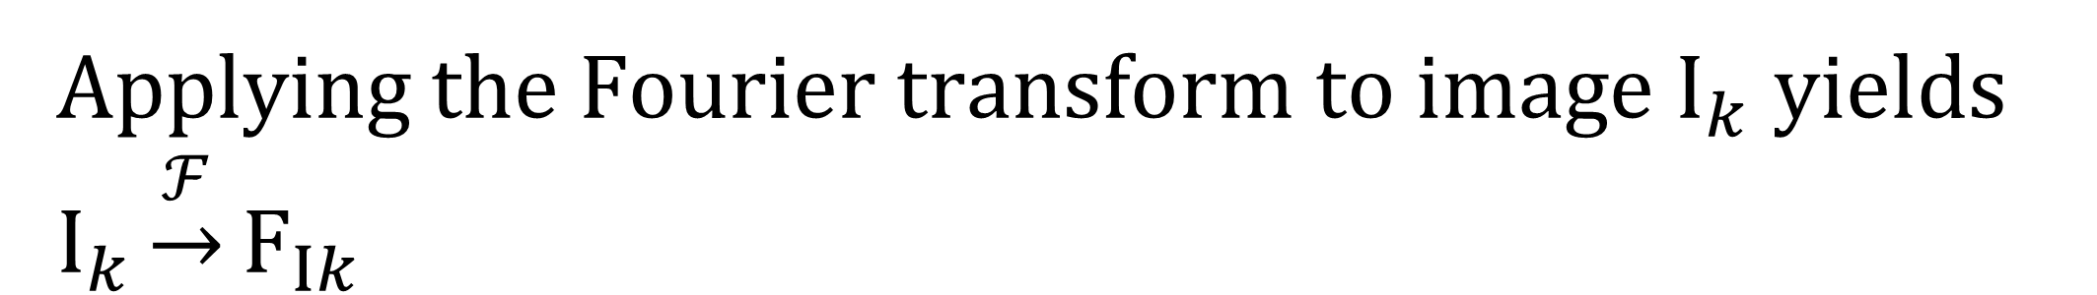
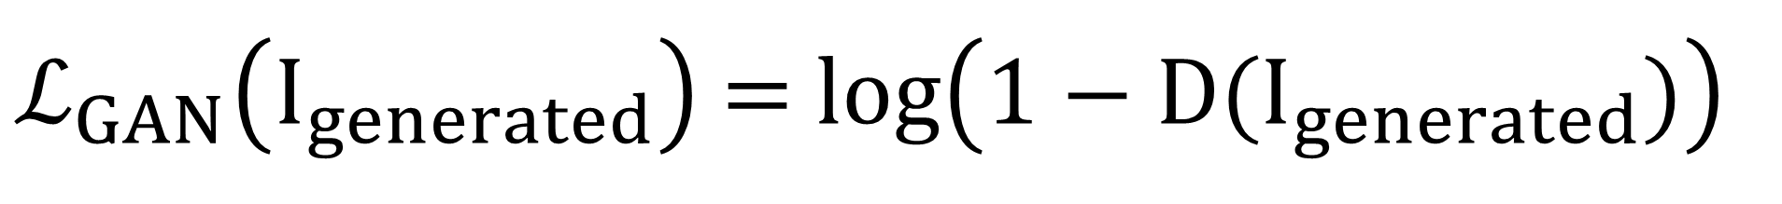
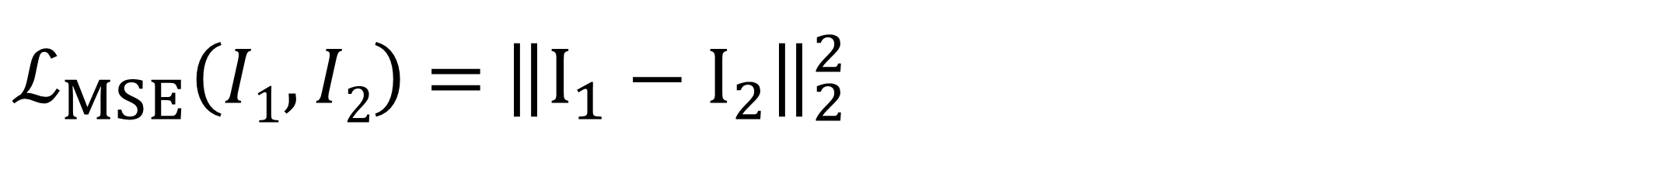
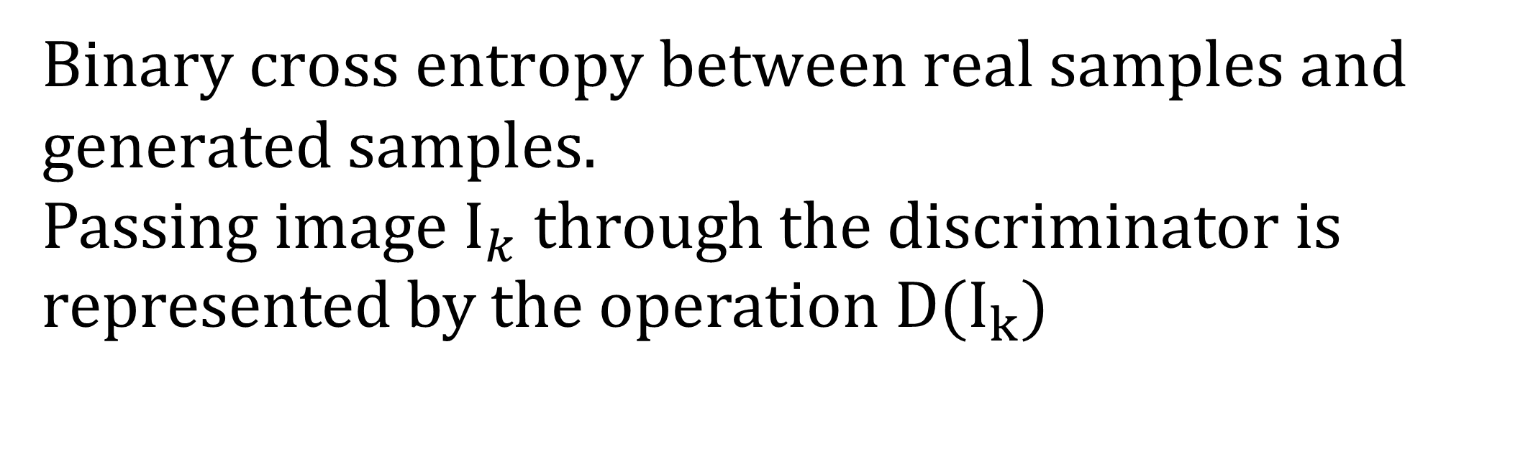
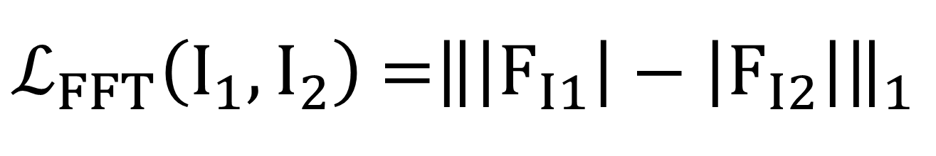
Fourier and Edge Loss for GAN-Based Super Resolution
Jason Plawinski, Michael Waechter, Yasuyuki Matsushita
Introduction
In super resolution tasks, objective functions such as MSE error poorly model human perception and lead to overly smooth results.
In this work we present an Edge loss and a Fourier loss to improve the quality of results and regularize GAN training.
Results
8x
4x
4x
Nearest
Bicubic
Super
Resolution x4
LR
Nearest Neighbor
Bicubic
Our method
Ground truth
MSE
Proposed Loss Function
MSE Loss
L2 norm between the target Image and the generated image
Edge + FFT
$ℒ_{MSE}\left(I1,I2\right)$ = ${\left\|I_{1}−I_{2}\right\|}_{2}^{2}$
Edge Loss
GAN
L1 norm between the intensity of the gradient of the target image and the generated image
$ℒ_{Edge}\left(I1,I2\right)$ = $\left\|S\left(I_{1}\right)−S(I_{2})\right\|$₁
W$here S(I_{k})$ is the Sobel-filtered of $I_{k}$
Ours
FFT Loss
L1 norm between the magnitude spectra of the target image and the generated image
Applying the Fourier transform to image $I_{k}$ yields $I_{k}\underset{→}{ℱ}F_{Ik}$
Ground
truth
$ℒ_{FFT}\left(I_{1},I_{2}\right)$ =${\left\|\left|F_{I1}\right|−\left|F_{I2}\right|\right\|}_{1}$
Adversarial Loss
Binary cross entropy between real samples and generated samples.
Passing image $I_{k}$ through the discriminator is represented by the operation $D(I_{k})$
Proposed Architecture
Generator
N Residual blocks
k9n3s1
LR
k9n64s1
k3n64s1
k3n64s1
k3n64s1
k3n64s1
$ℒ_{GAN}\left(I_{generated}\right)$ = $log\left(1−D(I_{generated})\right)$
Input
Conv
IN
Conv
Elementwise Sum
Conv
L-ReLU
Elementwise Sum
Conv
IN
L-ReLU
L-ReLU
Conv
Total Loss
PixelShuffler x2
SR
$ℒ_{Tot}$ = $ℒ_{MSE}$ + $α_{1} ℒ_{Edge}$ + $α_{2} ℒ_{FFT}{+ α}_{3}ℒ_{GAN}$
Discriminator
skip connection
Upscaling
module
k3n64s2
k3n128s1
k3n128s2
k3n256s1
k3n256s2
k3n3s1
SR
k3n512s1
Input
L-ReLU
Conv
Sigmoid
IN
Conv
L-ReLU
Conv
IN
L-ReLU
IN
Conv
L-ReLU
Conv
IN
L-ReLU
Conv
IN
L-ReLU
HR
Conv

